Slide 1


Electronics, Linux and Python
Tom Zimmerman
Cellular Engineering
IBM Research-Almaden
This material is based upon work supported by the NSF under Grant No. DBI-1548297.
Disclaimer: Any opinions, findings and conclusions or recommendations expressed in this material are those of the authors and do not necessarily reflect the views of the National Science Foundation.

Slide 2
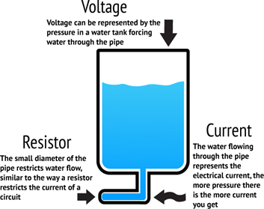
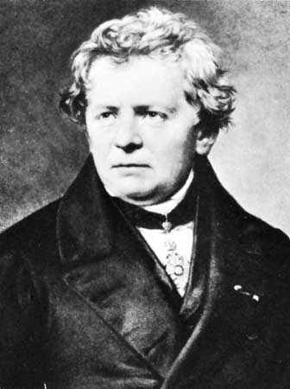
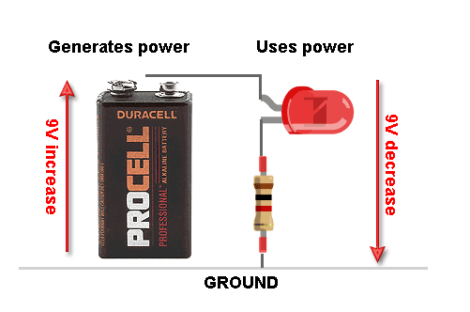
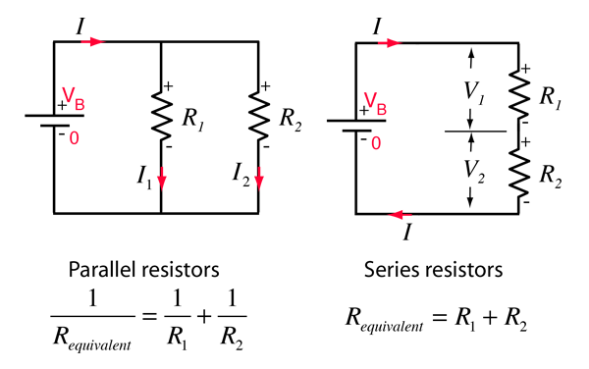
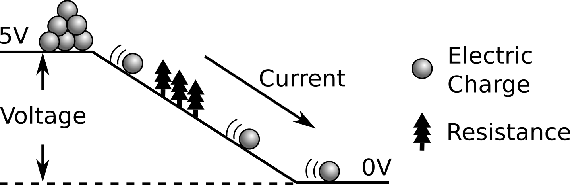
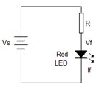
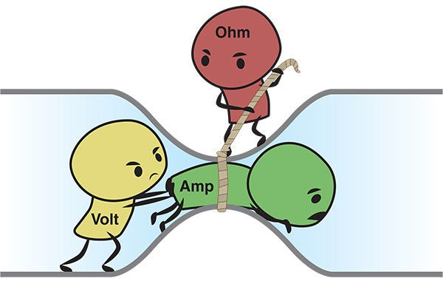
Basic Electric Circuits
Ohm’s Law
Voltage
--------------
Resistance
Current =
100 ohm
8 V
9V
2 V
https://learn.adafruit.com/assets/3904
http://www.harrypigot.com/nepal/activity11/
https://www.instructables.com/id/Ohms-Law-for-Dummies/
https://maker.pro/custom/tutorial/basics-of-ohms-law
http://hyperphysics.phy-astr.gsu.edu/hbase/electric/dcex3.html
https://stemstarsfall17.wordpress.com/2018/03/21/ohms-law-resistors-and-leds/
https://dmohankumar.wordpress.com/2015/09/10/ohms-law-and-led-resistor-simple-design-1/

Slide 3
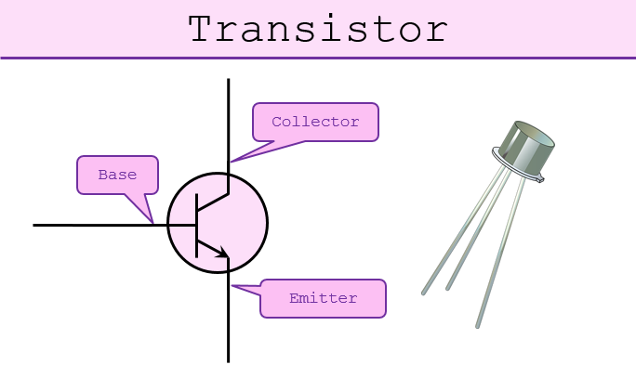
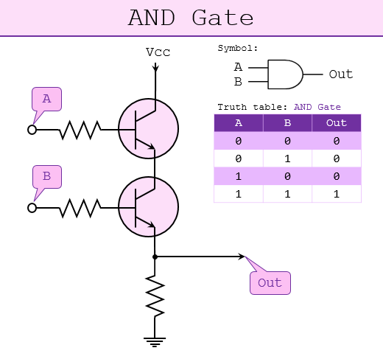
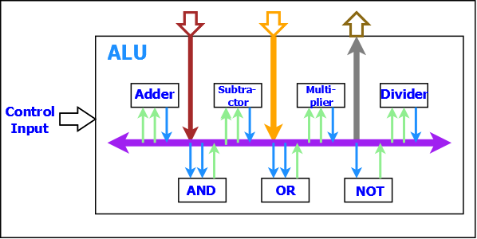
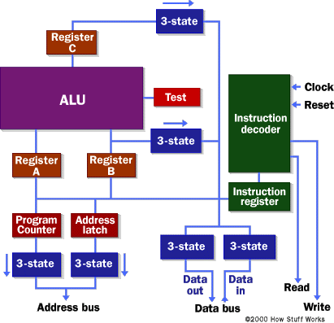
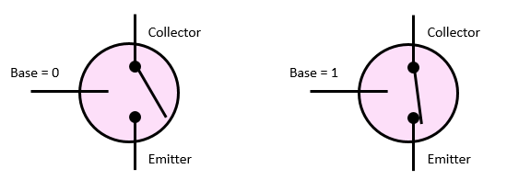
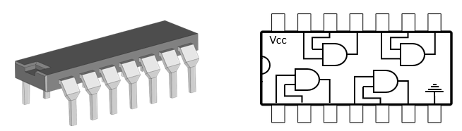
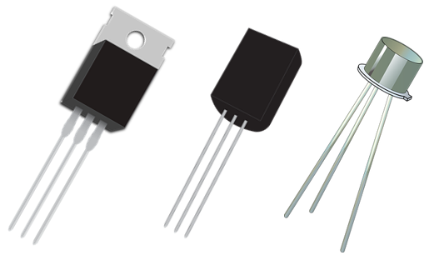
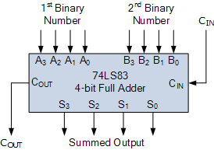
Transistors, Logic and Microcomputer
7408 Quad AND Gate (~40 transistors)
7483 4-bit Full Adder (~400 tr.)
21 billion Nvidia GV100 Volta (12 nm)
40 billion in AMD Zen2 (8 dies in single package 7 nm)
2 trillion Samsung 1 Tb NAND
https://www.quora.com/What-are-the-basic-components-of-a-microprocessor
https://www.101computing.net/from-transistors-to-micro-processors/

Slide 4
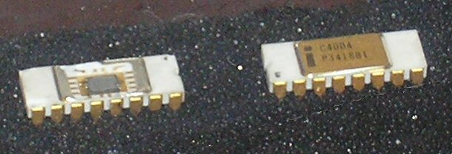
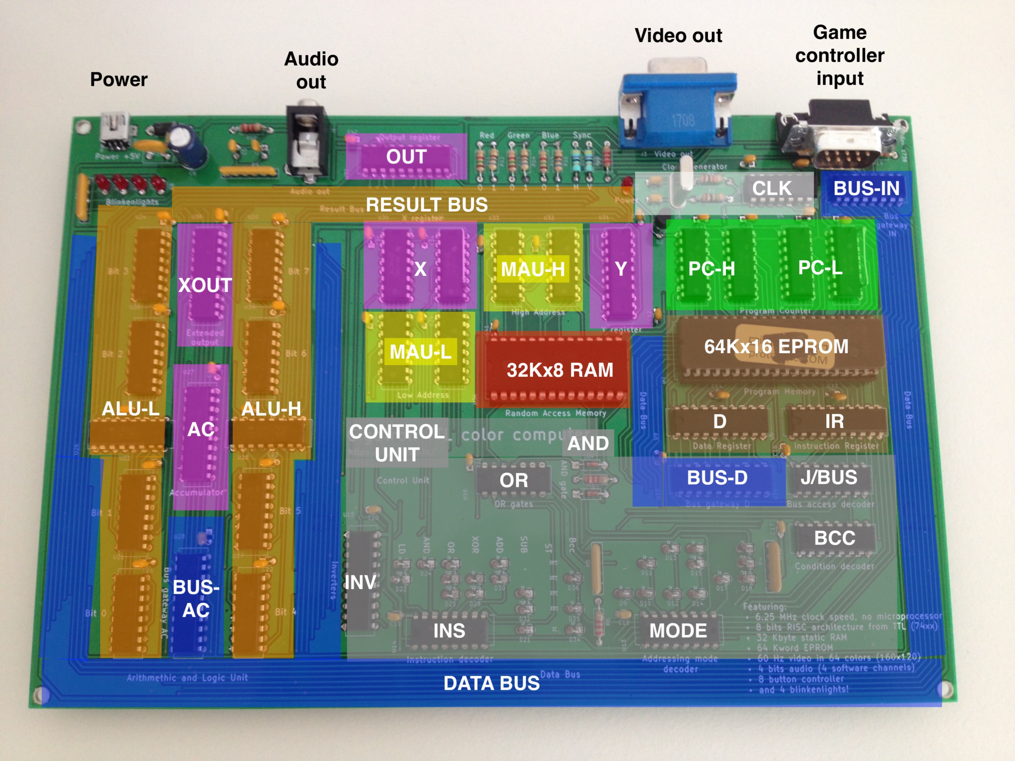
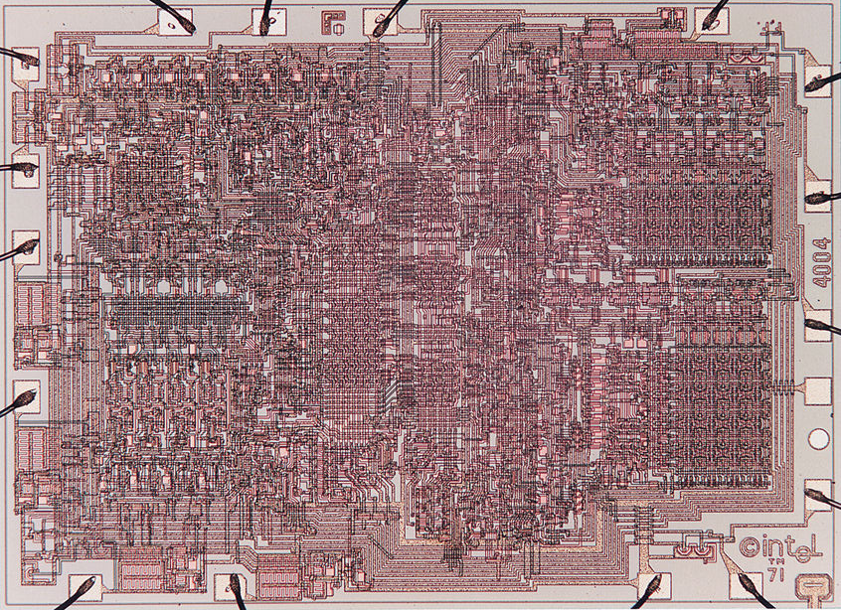
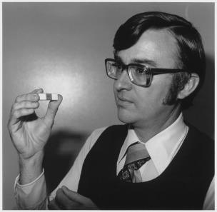
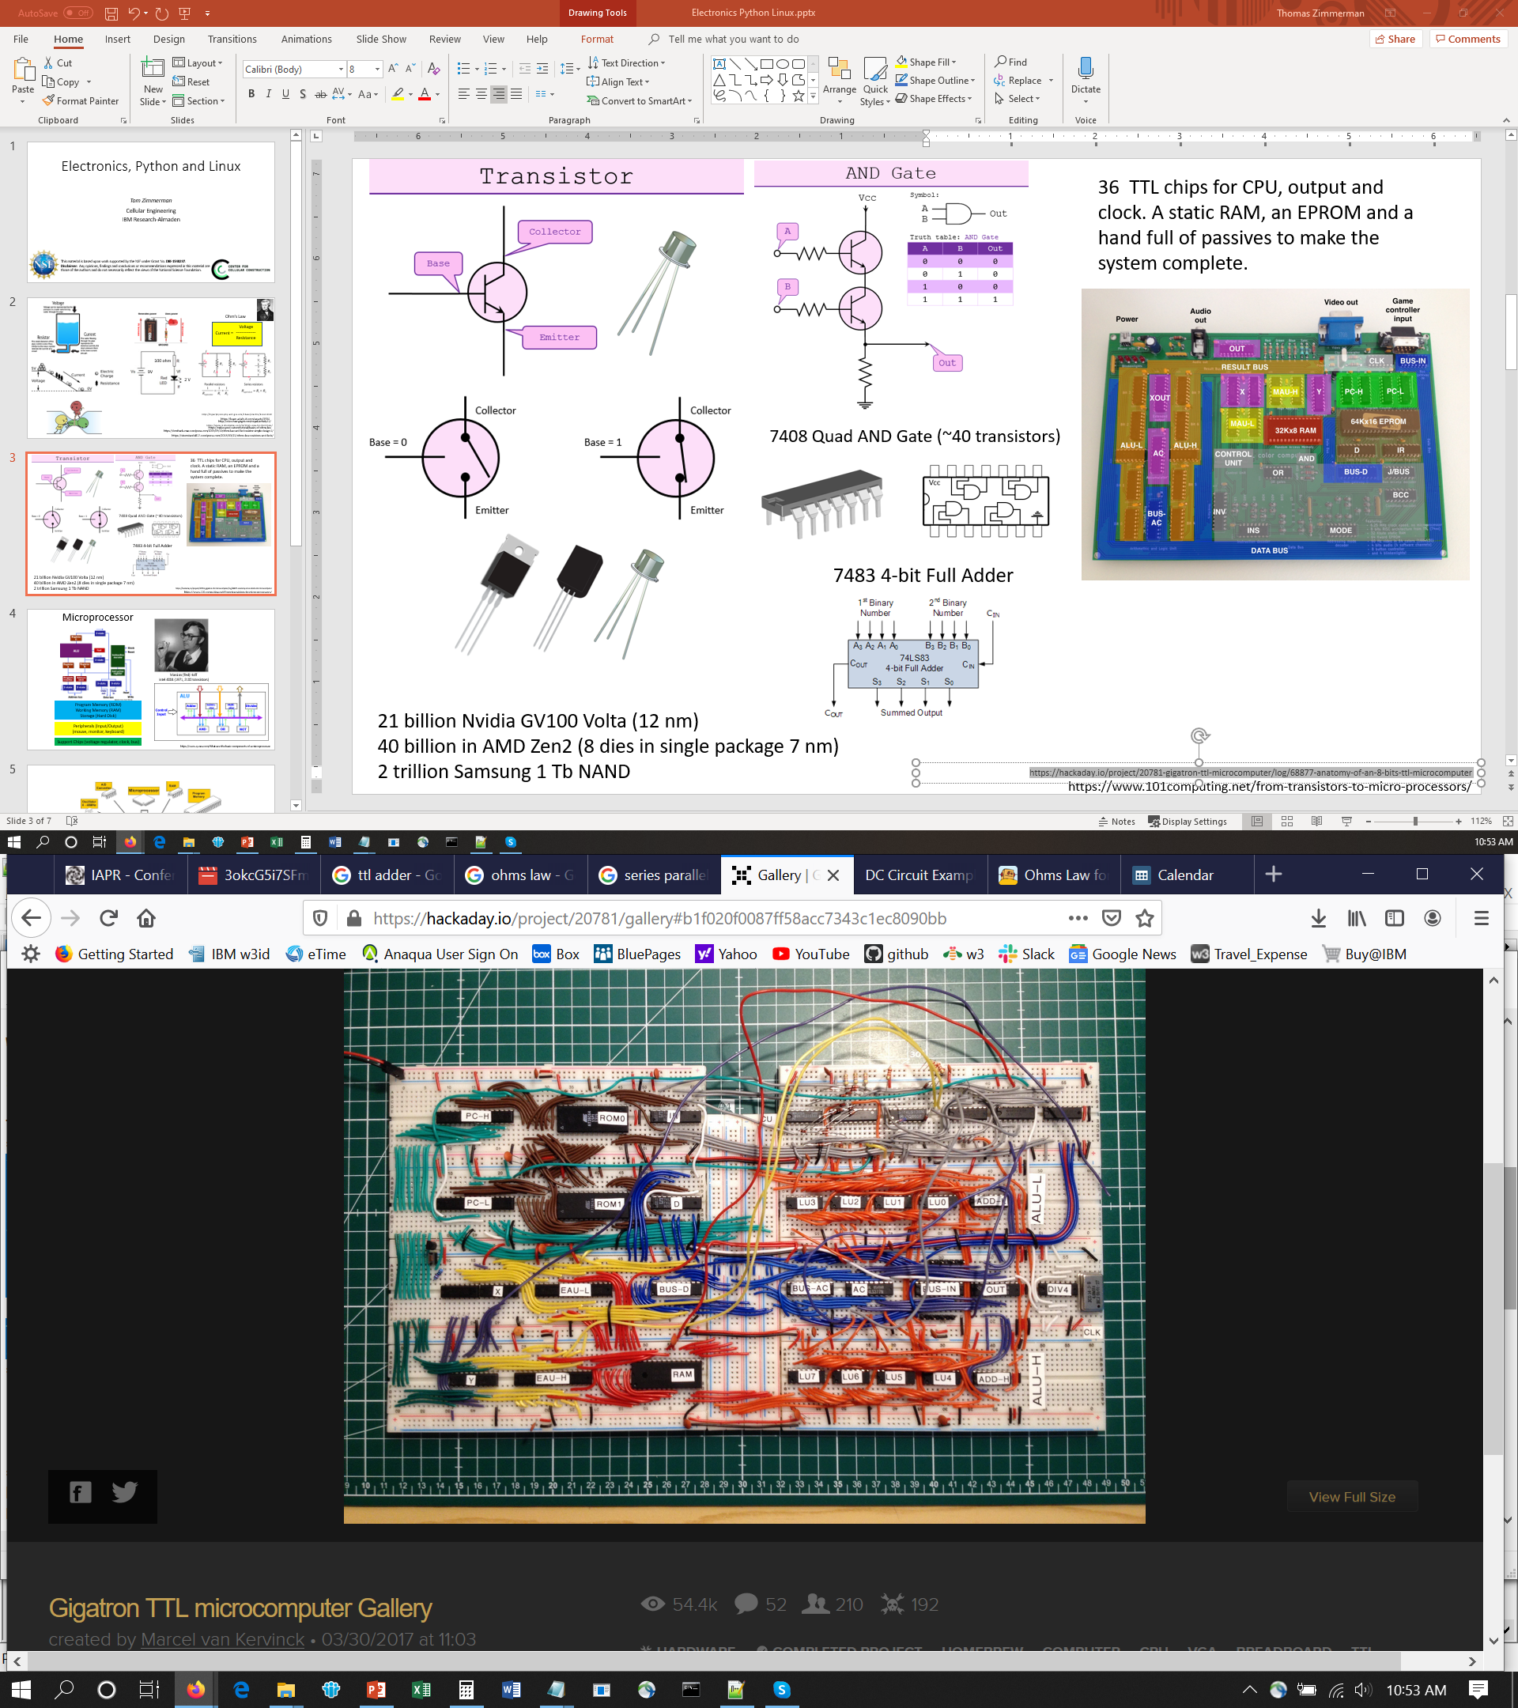
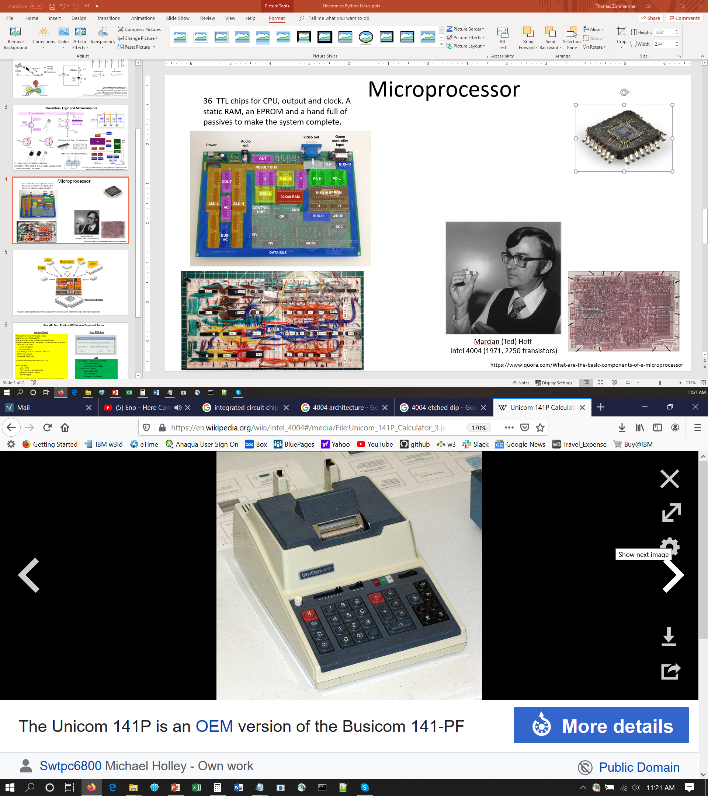
Microprocessor
36 TTL chips for CPU, output and clock. A static RAM, an EPROM and a hand full of passives to make the system complete.
Marcian (Ted) Hoff
Intel 4004 (1971, 2250 transistors)
Busicom 141-PF $695 1971
https://hackaday.io/project/20781-gigatron-ttl-microcomputer/log/68877-anatomy-of-an-8-bits-ttl-microcomputer
https://en.wikipedia.org/wiki/Intel_4004

Slide 5
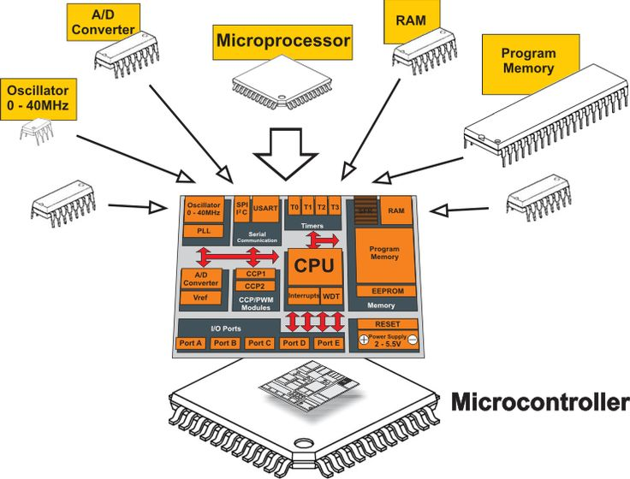
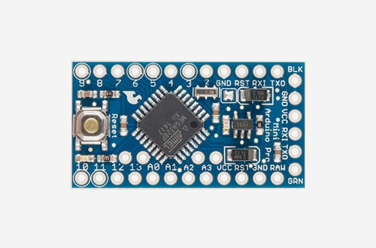
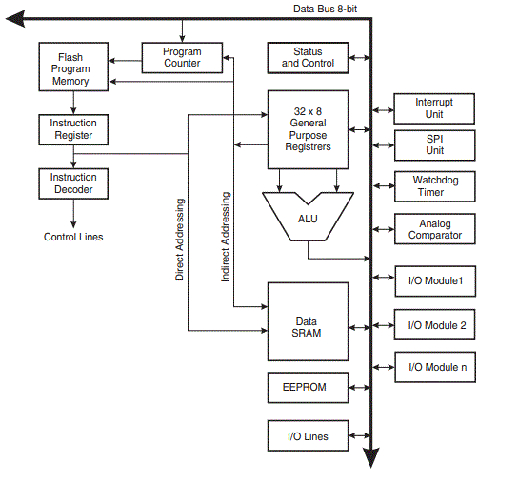
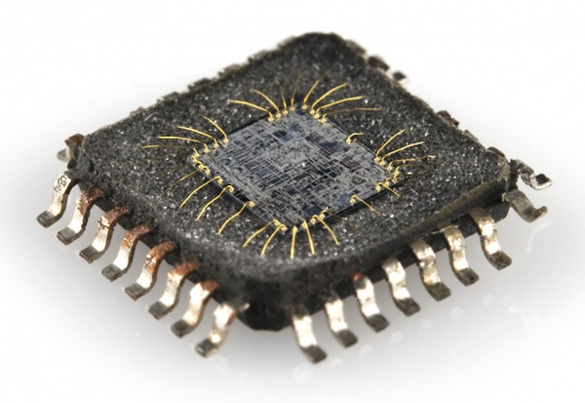
Microcontroller:
Microprocessor + Memory + Peripherals
Arduino with Atmel Microcontroller
https://learn.sparkfun.com/tutorials/integrated-circuits/all
http://exploreembedded.com/wiki/1._AVR_Architecture
https://electronicsforu.com/resources/difference-between-microprocessor-and-microcontroller

Slide 6
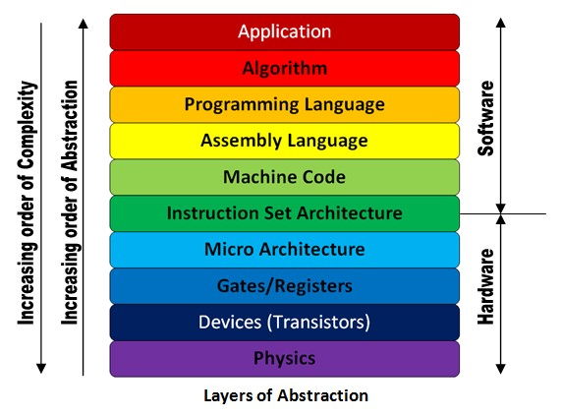
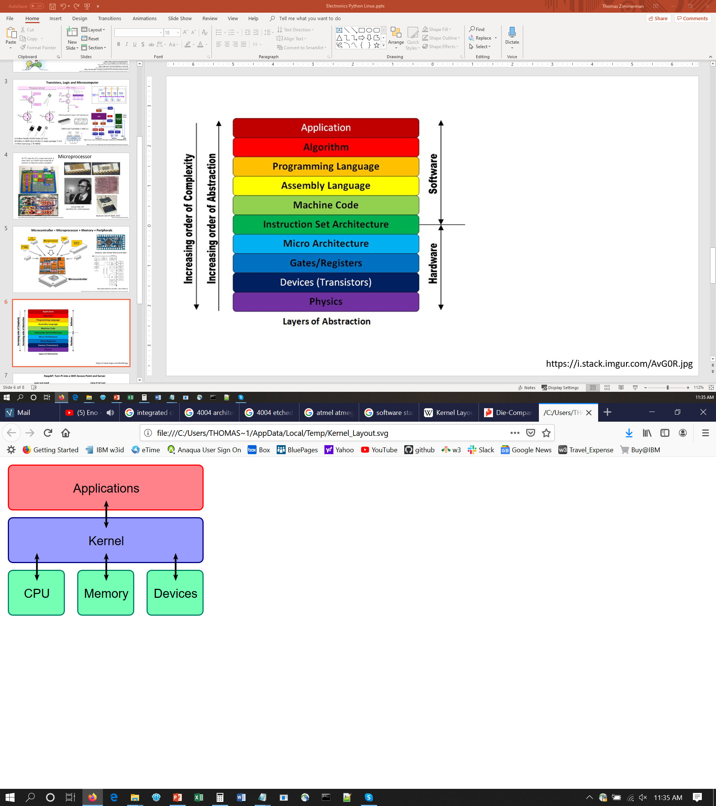


Programming and Operating System
https://i.stack.imgur.com/AvG0R.jpg
GNU Project => Linux OS
Linus Torvalds
https://en.wikipedia.org/wiki/Linux_kernel

Slide 7

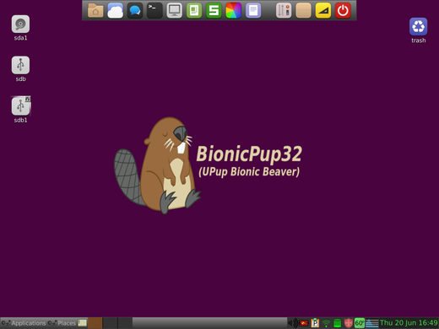
Installing and Running Puppy Linux
https://www.how2shout.com/how-to/how-to-install-puppy-linux-to-usb-using-windows-os.html
1 Download Puppy Linux
For Windows: UPupBB
Puppy Linux version based on Ubuntu 18.04 components. A Woof-CE 32-bit pae build of Puppy Linux using Ubuntu Bionic Beaver components. https://sourceforge.net/projects/zestypup/
For Mac: Macpup 550 is the latest based on Precise Puppy 5.5.0. It's an official woof build of puppy linux that is binary-compatible with Ubuntu Precise packages. http://macpup.org/
2. Download USB Programmer This app that lets you take the Puppy Linux you downloaded and load it into a USB drive. For Windows, Linux and MacOS; https://unetbootin.github.io/
3. Running PC/Mac with Puppy Linux
Put the USB drive in your machine, configure it to boot off the USB.
For Windows machine: Press the Power button for your computer.
During the initial startup screen, press ESC, F1, F2, F8 or F10. ...
When you choose to enter BIOS Setup, the setup utility page will appear. Using the arrow keys on your keyboard, select the BOOT tab. ...
Move USB to be first in the boot sequence.
For Mac: Go to System Preferences > Startup Disk. Click the lock and enter your password to change the settings. Select your USB drive from the list and click Restart.

Slide 8
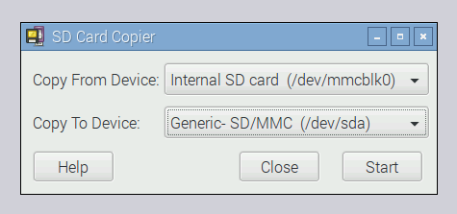
RaspAP: Turn Pi into a WiFi Access Point and Server
Learn and Install
Clone Pi SD Card
https://github.com/billz/raspap-webgui
https://youtu.be/TNPlqV418T8
After the reboot at the end of the installation the
wireless network will be configured as an access point as follows:
IP address: 10.3.141.1
Username: admin
Password: secret
DHCP range: 10.3.141.50 to 10.3.141.255
SSID: raspi-webgui
Password: ChangeMe
SSH name: raspberry default password: pi
WLAN Settings:
WPA+WPA2
PSK: change to something else
advanced choose country
enable logging
when SSH into Pi with Putty, find ip address by typing 'ifconfig'
sudo -i lets you run as administrator
transfer files with winscp or Filezilla
Use
1. Connect to Pi as Wifi Access Port
SSID=raspi-webgui
password=ChangeMe
2. Connect with Filezilla
Host: 10.3.141.1
Username:pi
Password: rapsberry
transfer speed ~ 1MB/sec
30 sec video = 63.5MB ~ 1 min to download

